Slide 1
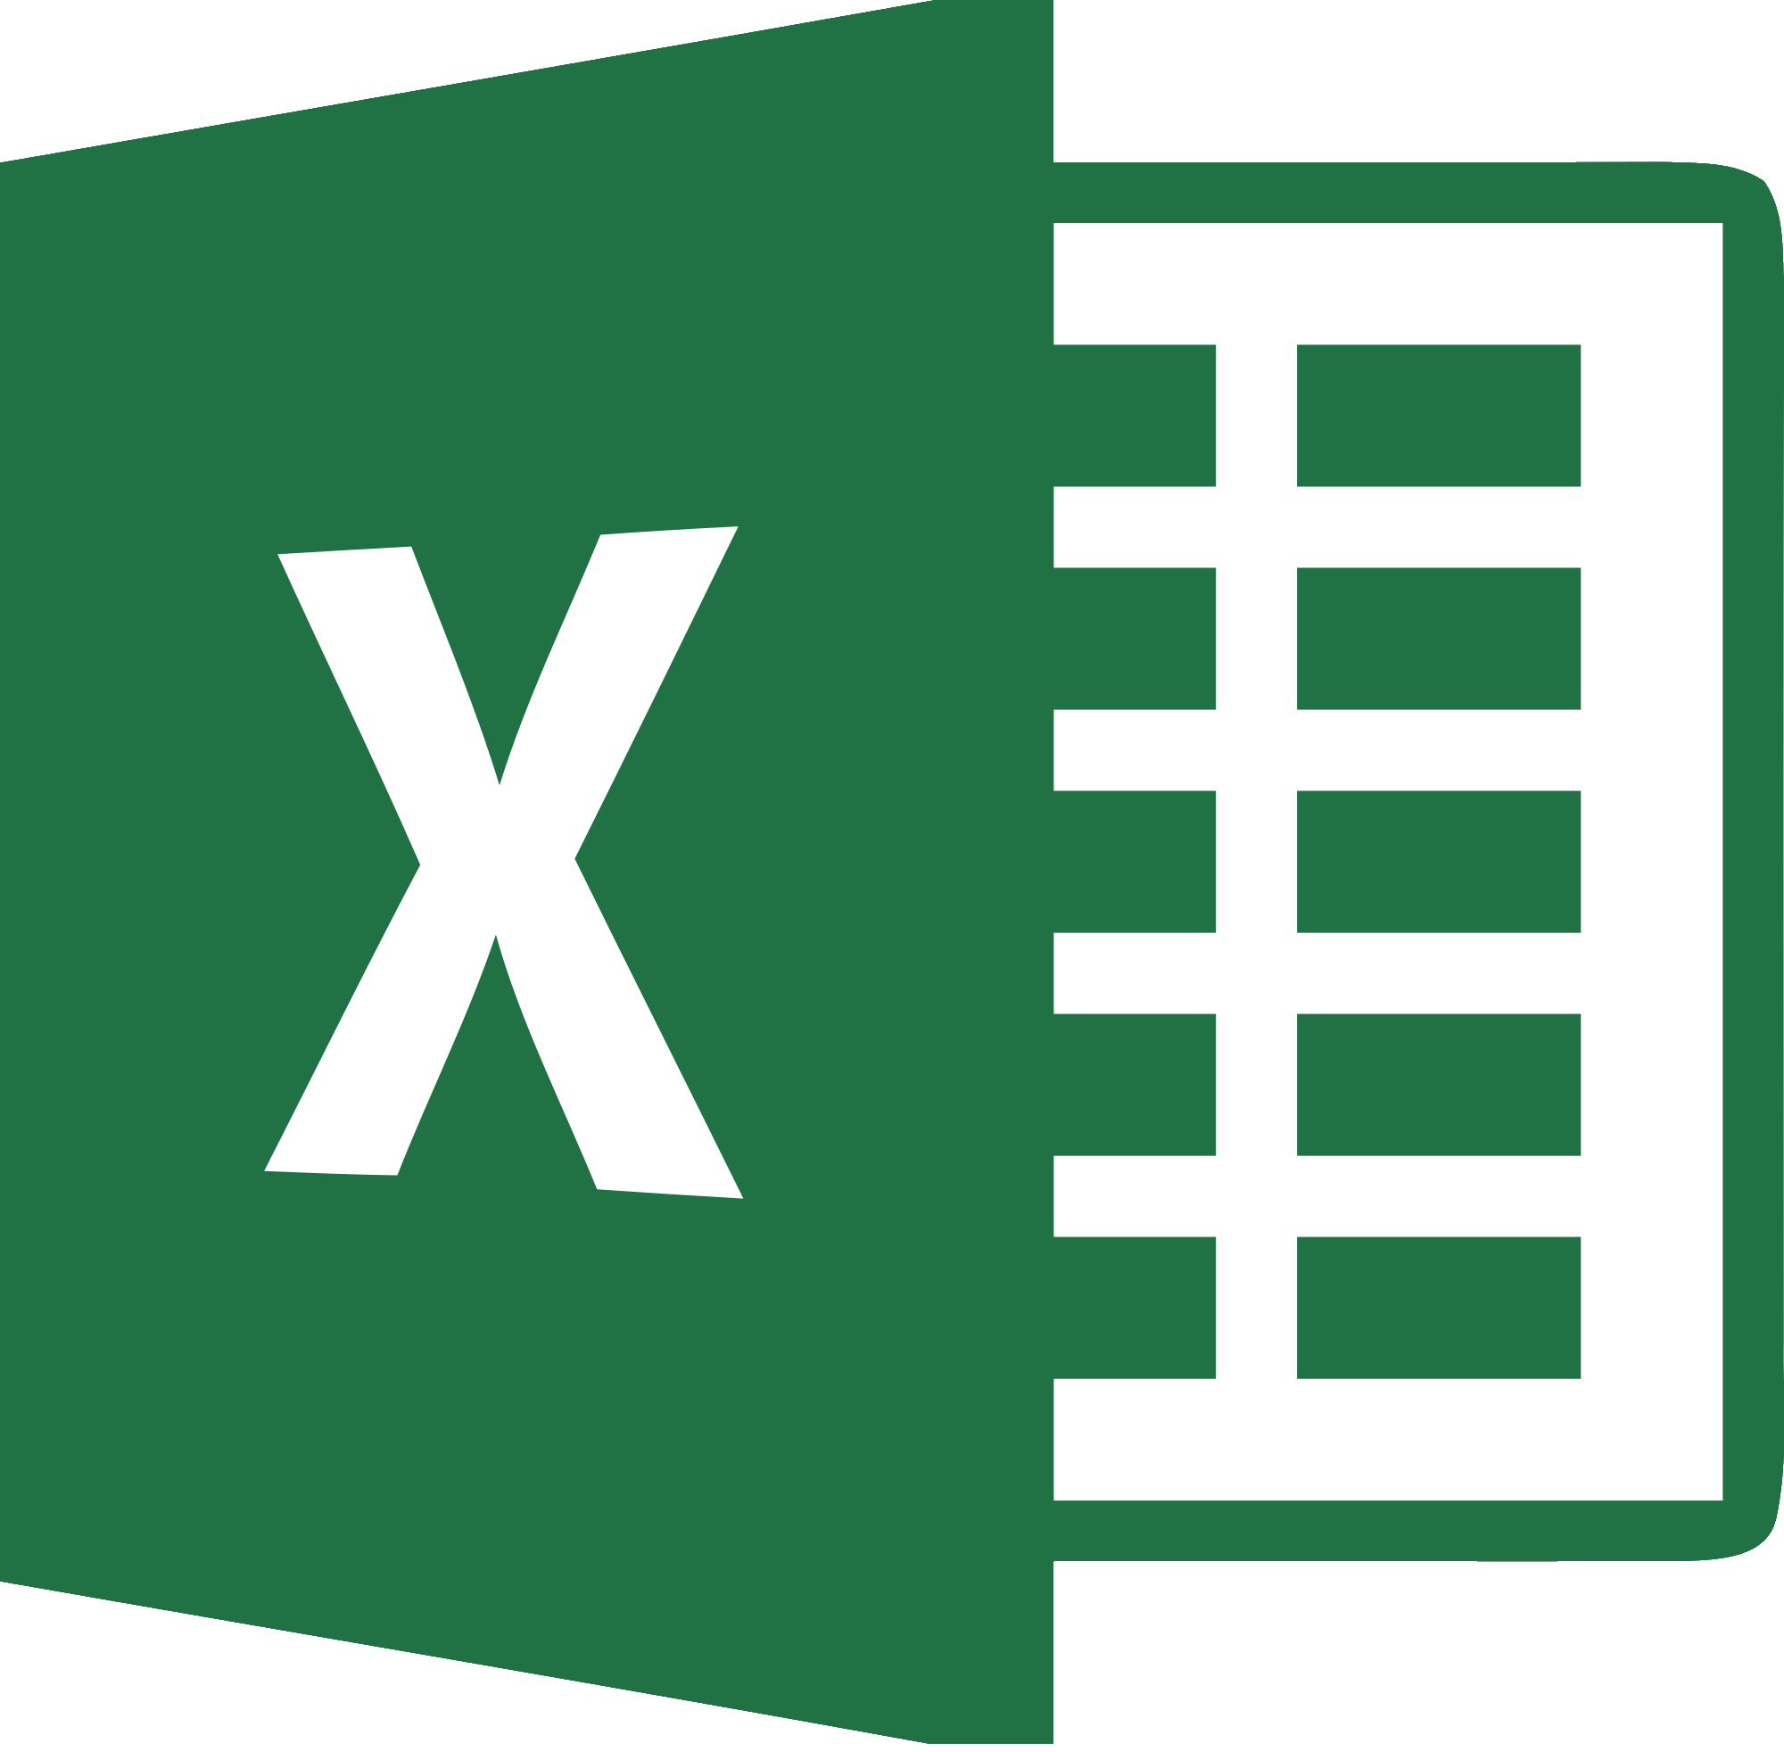
How To Use Excel for Good, and Not Evil
(Microsoft Excel for Developers)

Slide 2
What this talk is about:
Using Excel to help you as a developer
Using Excel formulas to generate code
Realistic examples where excel is useful for a software developer
Comparing database results using Excel
Pivot tables as an alternative to repetitive research queries
Importing JSON files into excel tables
Excel automation and macro programming

Slide 3
What this is NOT
Native applications that interact with .xls files
Linq to Excel
Apache POI
IronPython
(other libraries)
If you want to leave for a better talk, now is the time...

Slide 4
Who am I?
Name: Alan Wong
I’m in software development
(You can tell because I am using Consolas)
(It’s also in dark theme)

Slide 5

Why Excel?
What I told my boss…
“I used Excel to help me code”
Notes:
When I told my boss that I used Excel to semi-automatically write my code, I think his reaction was this…

Slide 6
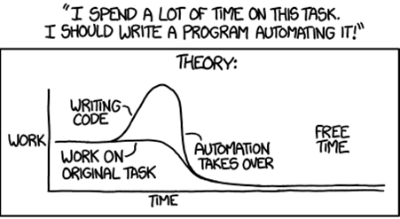
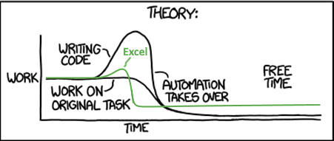
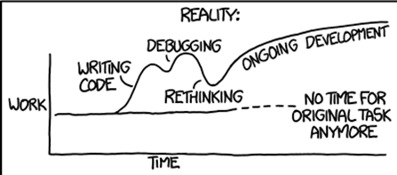
But Really.. Why?
https://xkcd.com/1319/

Slide 7


Bad Analogy Time
Excel is like a Swiss Army Knife..
It theoretically could do everything
(and it can also do everything badly
It is never the “right” tool for the job.
But often it is “good enough” and it’s there, convenient and easy to implement.

Slide 8
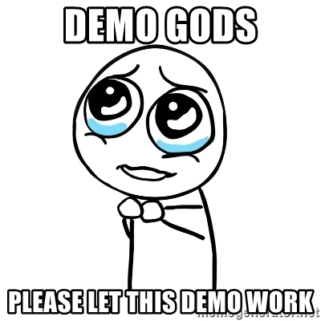
Demo time:
A Quick prayer to demo gods…

Slide 9
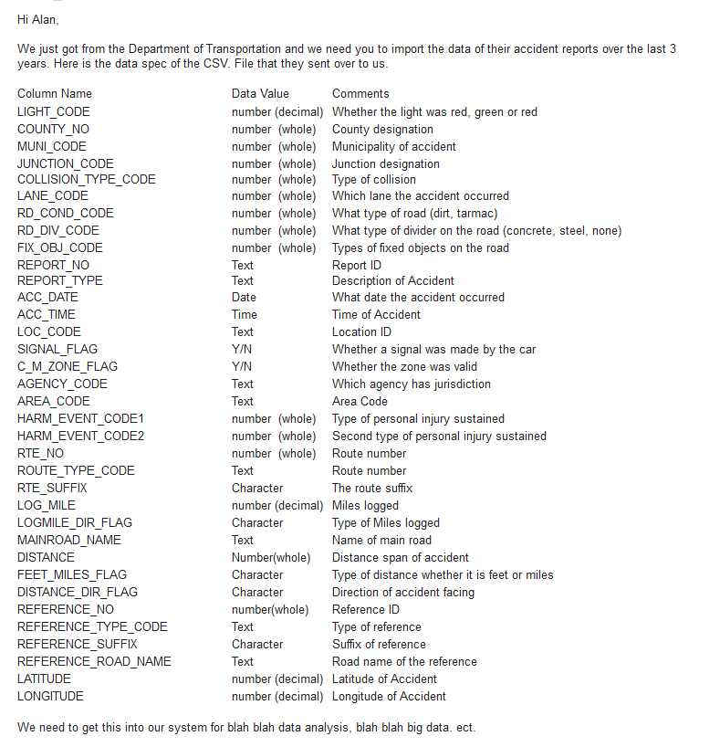
Creating ORM models using Excel
A typical scenario…

Slide 10
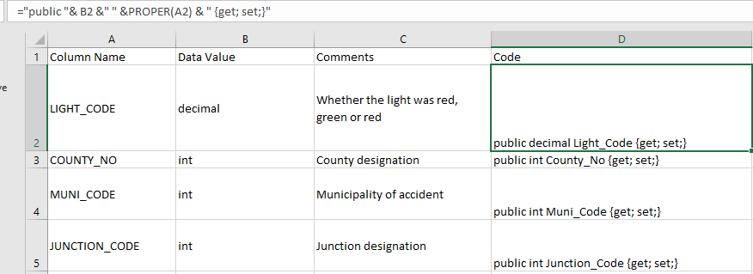
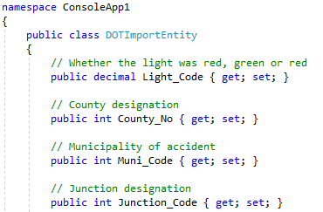
Creating Object properties (demo)
Notes:
="public "& B3 &" " &PROPER(A3) & " {get; set;}“
Paste values
Insert index above properties
Insert whitespace below rest of properties

Slide 11
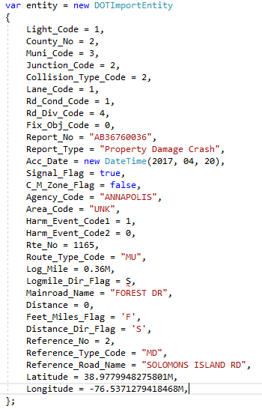
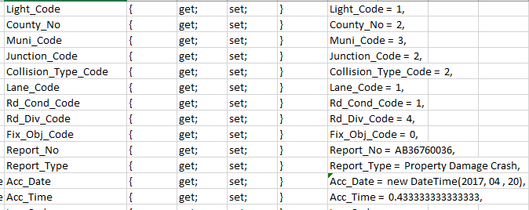
Instancing new object properties
Notes:
Find and replace with wild card
Text to columns

Slide 12
Vlookup Demo
Comparing results from two tables

Slide 13
Business Scenario
Payroll system
Car Sales (leases)
Commission based pay based on car options
(GPS, stereo, heated seats etc.)
Different car options have different commission rates
Sales people earn each week on continuous lease payments
Database:
Payroll records are backed up to separate server for archive purposes
Production server has payroll payments of this week
Archive server has payroll payments before this week

Slide 14
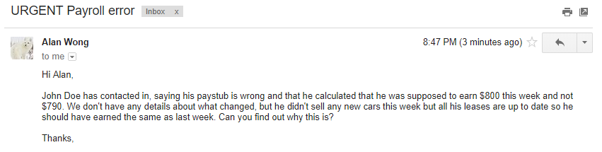
Example:

Slide 15
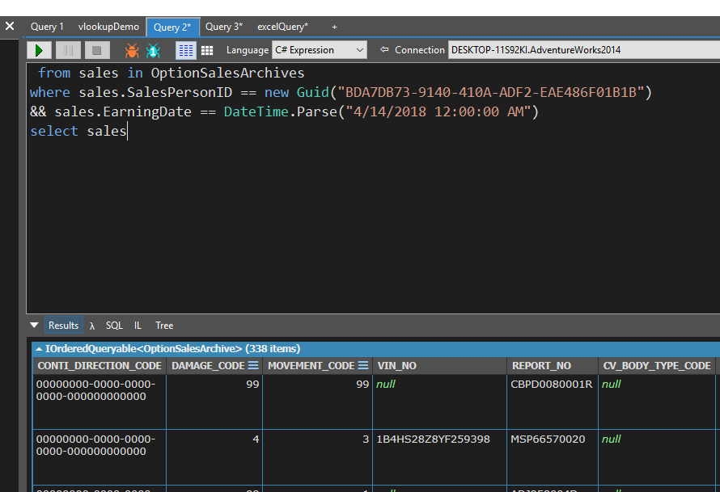
Demo

Slide 16
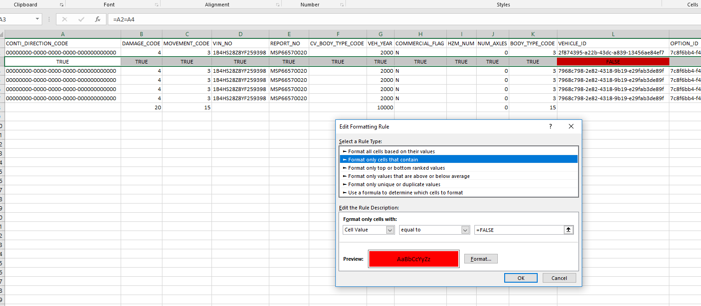
Conditional Formatting
Dealing with logs

Slide 17
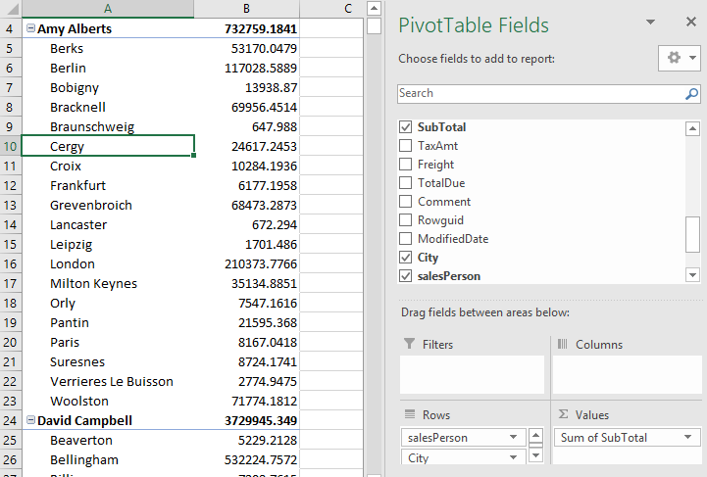
Pivot Tables

Slide 18
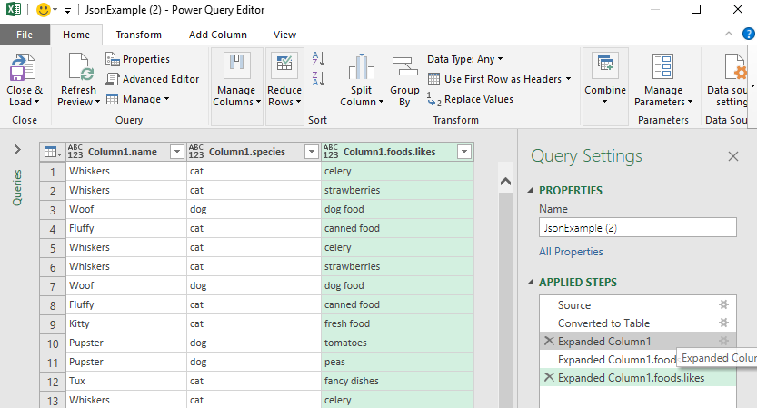
Importing .json files

Slide 19

VBA (Visual Basic Applications)

Slide 20

VBA’s Reception…
“Hey I can program, I made this VBA script!”

Slide 21
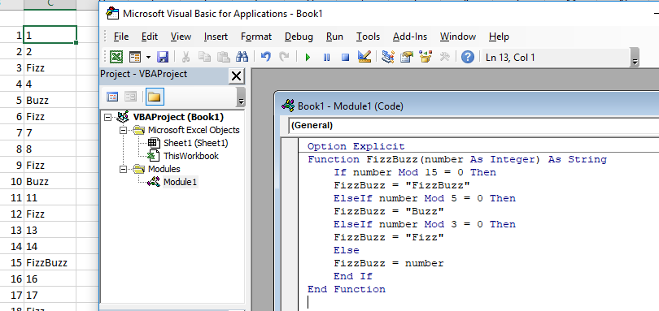
Basic Example
Notes:
Option Explicit
Function FizzBuzz(number As Integer) As String
If number Mod 15 = 0 Then
FizzBuzz = "FizzBuzz"
ElseIf number Mod 5 = 0 Then
FizzBuzz = "Buzz"
ElseIf number Mod 3 = 0 Then
FizzBuzz = "Fizz"
Else
FizzBuzz = number
End If
End Function

Slide 22
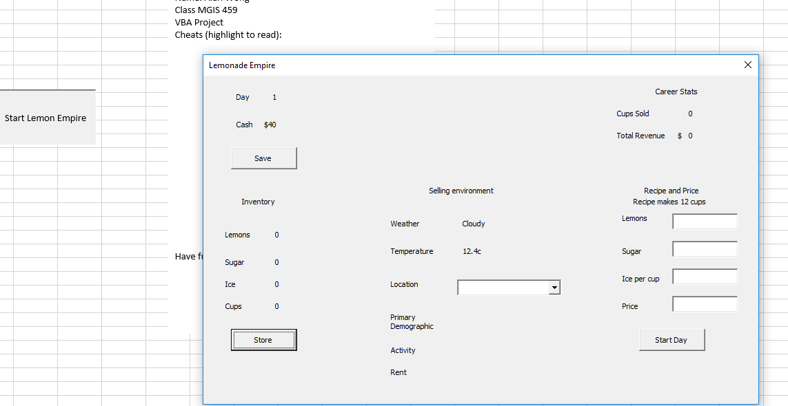
More Intricate Example

Slide 23

Let’s get stupid…

Slide 24
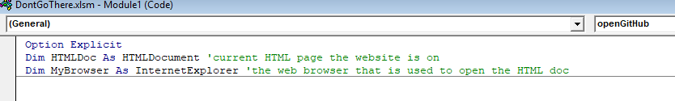
VBA to automate web browsing…

Slide 25
Is VBA good?
Great if you are the following
A hopeful developer looking to break into the field
Working a white collar desk job but not in software development
In a company with no internal software development
In a company that wont let you install or deploy software and development tools

Slide 26

Did this help?

Slide 27
Resources
“Excel is Fun” Youtube channel
https://www.youtube.com/user/ExcelIsFun
Microsoft MSDN for VBA excel
https://msdn.microsoft.com/en-us/vba/excel-vba/

Slide 28
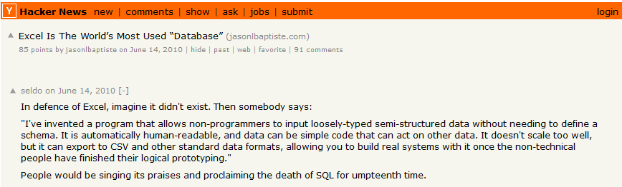
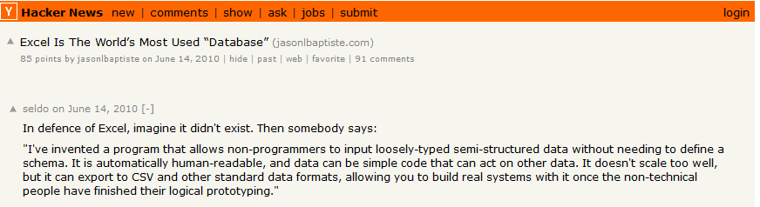
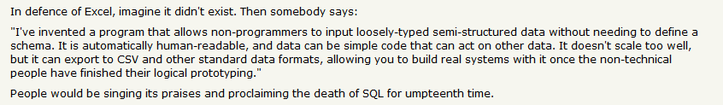
Favorite quote of Excel

Slide 29
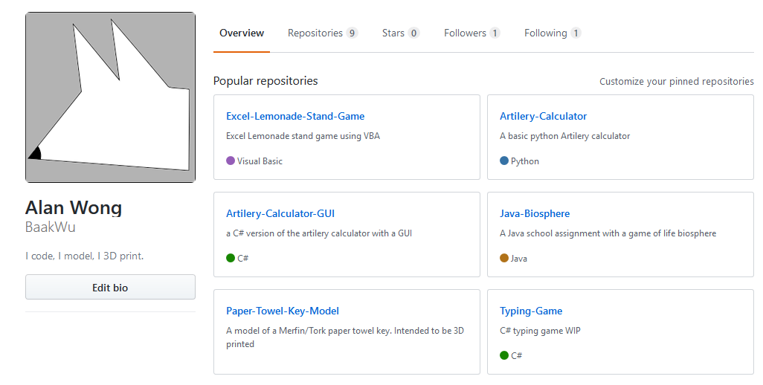
GitHub
https://github.com/BaakWu

